Slide 1
SYSTEM CALL
Over view for Linux system call

Slide 2
AGENDA
Introduction
System calls implementation
Accessing user-space from system call
Practice with system call

Slide 3
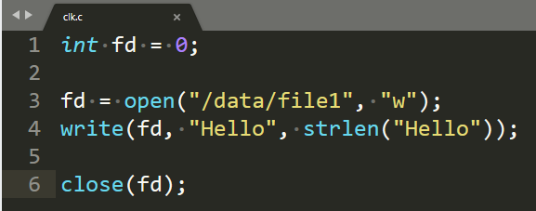
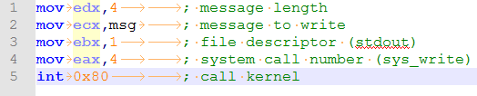
INTRODUCTION
Posix APIs and system call
We can use this code for many operation system:
int open(const char *pathname, int flags);
ssize_t write(int fd, const void *buf, size_t count);
int close(int fd);

Slide 4

System calls implementation

Slide 5
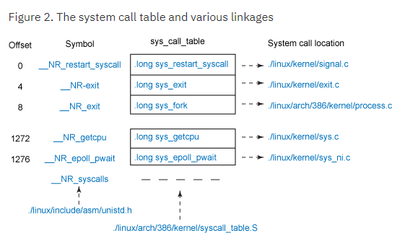
System calls implementation
System call table

Slide 6
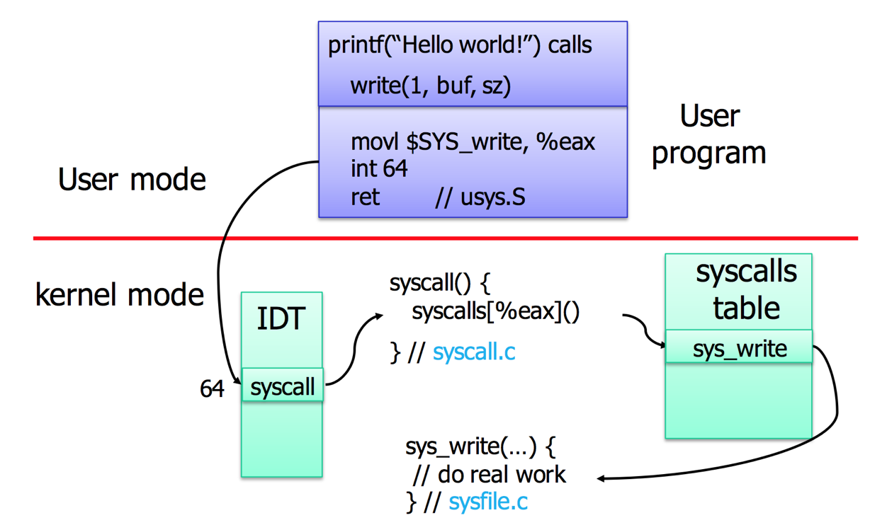
System calls implementation
Entering and exiting a system call

Slide 7
System calls switch context
Process will sleep when call an system call.
Full permission.
No user, no group, no limitation.

Slide 8
System calls implementation
System call parameter handling
Each system call have a different number of parameter.
Kernel have to check the validation of parameter.
Memory checking.
access_ok()
verify_area()

Slide 9
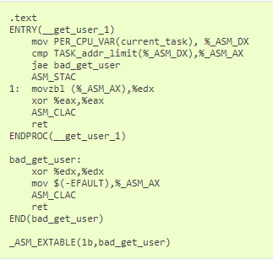
Accessing user-space from system call
Kernel code can not directly access to user-space memory.
get_user(), put_user(), copy_from_user(), copy_to_user().
Each assembly code have to cover when error happened.

Slide 10
Practice with system call
Swap a system call with kernel module
https://stackoverflow.com/questions/2103315/linux-kernel-system-call-hooking-example
Add new system call to kernel
https://www.ibm.com/developerworks/linux/library/l-system-calls/

Slide 11
Summary
Can not call a OS API with out system call.
How to call a system call.
Notes when call a system call.
Copy_to_user

Slide 12
Reference
Understanding the Linux kernel 3rd chapter 10.
https://www.ibm.com/developerworks/linux/library/l-system-calls/
http://www.linux.it/~rubini/docs/ksys/ksys.html

Slide 13

Thank you

